Slide 1
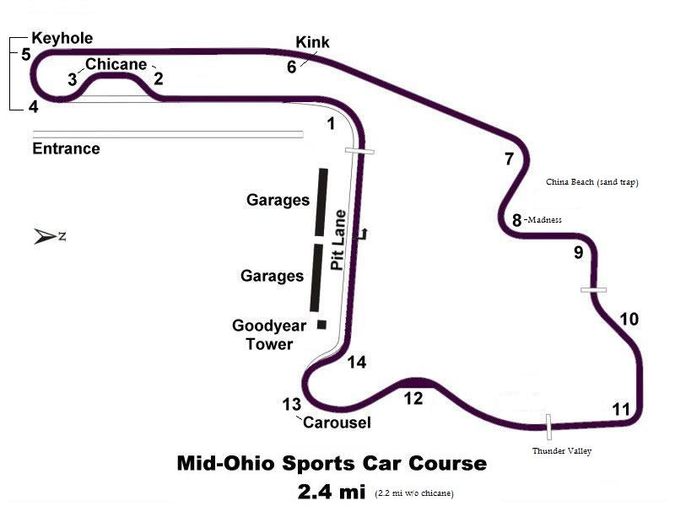
Hit apex, which is at access road junction
135 mph, hard braking, turn in at end of red & white wall when it turns all red. Can trail brake to advantage, apex T7, track out at middle of track & get straight, brake straight for T8
Avoid yellow track out curb as it can hook you inside. 92 mph
Apex is ~ 3/4 down on inside curb. STAY OFF CURB.
Turn in at metal plate on right (worker stand).
123 mph. Breathe off throttle (at most) before turn in. Brake hard after turn in. Look up for 3rd sign from right & aim at it.
DON’T LIFT! No trail braking. Turn into apex on curb 1’, unwind steering & gently apply power as you unwind steering
Look for leftmost loudspeaker & aim at it. Move track right and brake straight. Late apex T4. Go deep 2/3-3/4 towards track end before turning in for T5
Turn in late for T9 apex, get straight, move left
Apex late, get lined up to be on straight line to track out ASAP & when set, apply power. Can go on yellow curb track out left safely. FOR ADVANCED STUDENTS ONLY - can briefly lift just after crest of hill to rotate car to get to apex easier
Hug yellow curb track left, stay on it for both yellow sections
Settle car, steer to left, apply power after apex. Can use yellow curb track right at track out.
Apex & get straight, then brake hard for T11
Be patient, turn in fully at blacktop right angle about there. Apex.
Turn in when LF wheel hits pavement change
Stay off all red & white curbs in general. Some exceptions
Brake straight, turn in slowly.
Get straight by 200’ marker track right, brake, turn in & hit apex track left. If car is settled, can apply full power to track out yellow curb. Go straight, aim for tent door
Stay steady over crest, DON’T LIFT, unwind wheel, squeeze power on, stay track left, use curb for apex.

